Slide 1
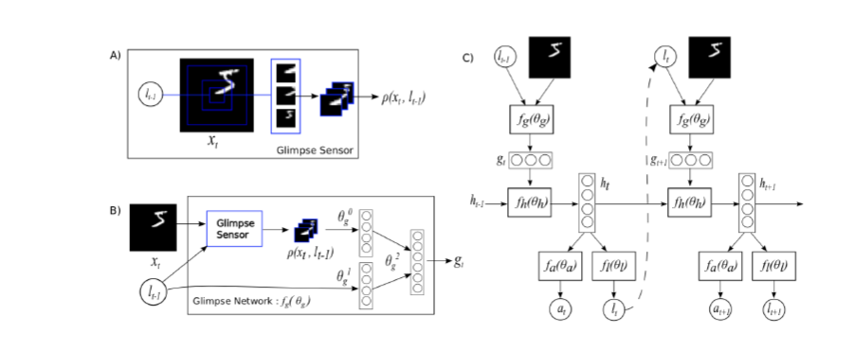
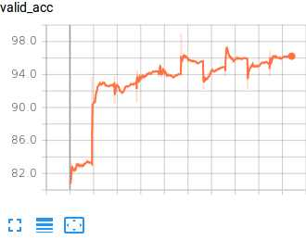
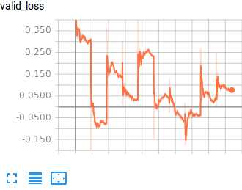
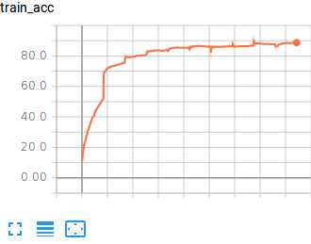
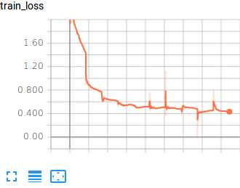
MATH 6380O Project 3: Image Classification with Recurrent Attention Models
Ping Liu¹, Yixuan Liu¹ , Yi Rong¹ and Chang Zhu¹
¹: Department of Mathematics, HKUST
1. Introduction
4. Diagram of RAM
7. Validation
We implement the recurrent attention model introduced by [1] and reproduce some key result of the paper.
2. Dataset
MINIST data set, Translated MINIST dataset, Cluttered MINIST dataset
8. Conclusion
3.Model
Advantage
RAM is able to ignore clutter present in an image by centering its retina on the relevant regions; both the number of parameters and the amount of computation RAM perform can be controlled independently of size of the input images.
Disadvantage
RAM is not differentiable, it has to be trained end-to-end from pixel inputs to actions using a policy gradient method.
Glimpse Sensor: Glimpse Sensor takes a full-sized image and a location, outputs the retina-like representation p(x(t),l(t-1)) of the image x(t) around the given location l(t-1).
Glimpse Network: takes as the inputs the retina representation p(x(t),l(t-1)) and glimpse location l(t-1), and maps them into a hidden space using independent linear layers parameterized by Ѳ(0,g) and Ѳ(1,g) respectively using rectified units followed by another linear layer Ѳ(2,g) to combine the information from both components. Finally it outputs a glimpse representation g(t).
Recurrent Neural Network (RNN): Overall, the model is an RNN. The core network takes as the input the glimpse representation g(t) at each step and history internal state h(t-1), then outputs a transition to a new state h(t), which is then mapped to action a(t) by an action network fa(Ѳ(a)) and a new location l(t) by a location network fl(Ѳ(t)). The location is to give an attention at next step, while the action, for image classification, gives a prediction based on current information. The prediction result, then, is used to generate the reward point, which is used to train these networks using Reinforcement Learning.
5. Illustration of glimpse in translated and cluttered MINIST
9. Reference
[1] Mnih, Volodymyr, Hees, Nicolas, Graves, Alex, and Kavukcuoglu, Koray. Recurrent models of visual attention. In NIPS, 2014.
6. Training
10. Contribution
Experiments
Yi Rong, Ping Liu, Yixuan Liu, Chang Zhu
Poster
Ping Liu, Yi Rong, Yixuan Liu, Chang Zhu

